Slide 1
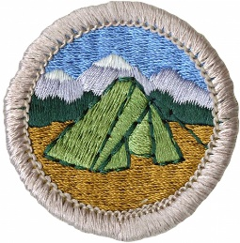
Camping Merit Badge
Troop 344/9344
Pemberville, OH

Slide 2

Camping Merit Badge
Do the following:
  Explain to your counselor the most likely hazards you may encounter while participating in camping activities and what you should do to anticipate, help prevent, mitigate, and respond to these hazards.
  Discuss with your counselor why it is important to be aware of weather conditions before and during your camping activities. Tell how you can prepare should the weather turn bad during your campouts.
  Show that you know first aid for and how to prevent injuries or illnesses that could occur while camping, including hypothermia, frostbite, heat reactions, dehydration, altitude sickness, insect stings, tick bites, snakebite, blisters, and hyperventilation.
Learn the Leave No Trace principles and the Outdoor Code and explain what they mean. Write a personal plan for implementing these principles on your next outing.

Slide 3
Camping Merit Badge
Make a written plan for an overnight trek and show how to get to your camping spot using a topographical map and
  a compass
  a GPS receiver
  a smartphone with a GPS app
Do the following:
  Make a duty roster showing how your patrol is organized for an actual overnight campout. List assignments for each member.
  Help a Scout patrol or a Webelos Scout unit in your area prepare for an actual campout, including creating the duty roster, menu planning, equipment needs, general planning, and setting up camp.

Slide 4
Camping Merit Badge
Do the following:
  Prepare a list of clothing you would need for overnight campouts in both warm and cold weather. Explain the term 'layering'.
  Discuss footwear for different kinds of weather and how the right footwear is important for protecting your feet.
  Explain the proper care and storage of camping equipment (clothing, footwear, bedding).
  List the outdoor essentials necessary for any campout, and explain why each item is needed.
  Present yourself to your Scoutmaster with your pack for inspection. Be correctly clothed and equipped for an overnight campout.

Slide 5
Camping Merit Badge
Do the following:
  Describe the features of four types of tents, when and where they could be used, and how to care for tents. Working with another Scout, pitch a tent.
  Discuss the importance of camp sanitation and tell why water treatment is essential. Then demonstrate two ways to treat water.
  Describe the factors to be considered in deciding where to pitch your tent.
  Tell the difference between internal- and external-frame packs. Discuss the advantages and disadvantages of each.
  Discuss the types of sleeping bags and what kind would be suitable for different conditions. Explain the proper care of your sleeping bag and how to keep it dry. Make a comfortable ground bed.
Prepare for an overnight campout with your patrol by doing the following:
  Make a checklist of personal and patrol gear that will be needed.
  Pack your own gear and your share of the patrol equipment and food for proper carrying. Show that your pack is right for quickly getting what is needed first, and that it has been assembled properly for comfort, weight, balance, size, and neatness.

Slide 6
Camping Merit Badge
Do the following:
  Explain the safety procedures for:
    Using a propane or butane/propane stove
    Using a liquid fuel stove
    Proper storage of extra fuel
  Discuss the advantages and disadvantages of different types of lightweight cooking stoves.
  Prepare a camp menu. Explain how the menu would differ from a menu for a backpacking or float trip. Give recipes and make a food list for your patrol. Plan two breakfasts, three lunches, and two suppers. Discuss how to protect your food against bad weather, animals, and contamination.
  While camping in the outdoors, cook at least one breakfast, one lunch, and one dinner for your patrol from the meals you have planned for requirement 8c. At least one of those meals must be a trail meal requiring the use of a lightweight stove.

Slide 7
Camping Merit Badge
Show experience in camping by doing the following:
  Camp a total of at least 20 nights at designated Scouting activities or events. One long-term camping experience of up to six consecutive nights may be applied toward this requirement. Sleep each night under the sky or in a tent you have pitched. If the camp provides a tent that has already been pitched, you need not pitch your own tent.
  On any of these camping experiences, you must do TWO of the following, only with proper preparation and under qualified supervision:
    Hike up a mountain where, at some point, you are at least 1,000 feet higher in elevation from where you started.
    Backpack, snowshoe, or cross-country ski for at least four miles.
    Take a bike trip of at least 15 miles or at least four hours.
    Take a non-motorized trip on the water of at least four hours or 5 miles.
    Plan and carry out an overnight snow camping experience.
    Rappel down a rappel route of 30 feet or more.
  On any of these camping experiences, perform a conservation project approved by the landowner or land managing agency. This can be done alone or with others.

Slide 8
Camping Merit Badge
Discuss how the things you did to earn this badge have taught you about personal health and safety, survival, public health, conservation, and good citizenship. In your discussion, tell how Scout spirit and the Scout Oath and Law apply to camping and outdoor ethics.

Slide 9
Requirement 1a
Explain to your counselor the most likely hazards you may encounter while participating in camping activities and what you should do to anticipate, help prevent, mitigate, and respond to these hazards.

Slide 10
1a Hazards
The most typical hazards you’ll encounter while camping are:
  Unexpectedly Cold Weather Conditions
  Insect Bites/Stings
  Dangerous Wild Animals
  Excessive rain/Flooding
  Heat-Related Injuries
  Accidental Injury From Knives or Fire
Many of these issues can be prevented by being prepared in your packing and can be responded to by removing the affected person from the hazardous environment, then treating them accordingly.

Slide 11
Requirement 1b
Discuss with your counselor why it is important to be aware of weather conditions before and during your camping activities. Tell how you can prepare should the weather turn bad during your campouts.

Slide 12
1b Weather
Weather and terrain are two important factors to consider when planning a campout.
  Although you should always be prepared in your packing, it is important to also be aware of potentially hazardous outdoor conditions and to respond accordingly.
Weather conditions such as warnings of heavy rains, snowstorms, strong winds, or any sort of natural disaster will require you cancel your planned campout.
  These situations can be extremely dangerous and make it easy for scouts to be separated from the group.
  To reduce risk during any camp, stick with a buddy at all times.
Always have a plan to evacuate.
  If the weather should turn, be ready to store your belongings and ensure that everyone is accounted for.
  In the event of heavy storms or natural disasters, be sure to have access to a scout leader with a phone so that emergency services can be contacted if necessary.
When in doubt, don’t go out.

Slide 13
Requirement 1c
Show that you know first aid for and how to prevent injuries or illnesses that could occur while camping, including hypothermia, frostbite, heat reactions, dehydration, altitude sickness, insect stings, tick bites, snakebite, blisters, and hyperventilation.

Slide 14
1c. First Aid
Hypothermia
Heatstroke and heat exhaustion
Frostbite
Dehydration
Sunburn
Insect stings and tick bites
Snakebite
Blisters
Altitude sickness.
First aid requirements for Tenderfoot, 2nd Class, First Class, and the First Aid Merit Badge cover all of these except for altitude sickness.

Slide 15
Altitude Sickness
Camping may take you to high places where altitude sickness (also known as AMS, or Acute Mountain Sickness) can be a concern.
Altitude sickness is seldom a problem for people at elevations of less than 8,000 feet above sea level.
High altitudes may leave you short of breath due to less oxygen.
Your body will acclimate to higher altitudes within a few days by producing extra red blood cells to carry more oxygen.
To help prevent altitude sickness:
  Drink plenty of fluids.
  Ascend gradually and permit your body to acclimate as you go higher (increase your altitude by no more than 1,000 feet/day).

Slide 16
Requirement 2
Learn the Leave No Trace principles and the Outdoor Code and explain what they mean. Write a personal plan for implementing these principles on your next outing.

Slide 17
2. Leave No Trace
Outdoor Code
Leave No Trace
Outdoor Code
Plan ahead and prepare.
Travel and camp on durable surfaces.
Dispose of waste properly.
Leave what you find.
Minimize campfire impacts.
Respect wildlife.
Be considerate of other visitors.
As an American, I will do my best to:
  Be clean in my outdoor manners.
  Be careful with fire.
  Be considerate in the outdoors.
  Be conservation minded.

Slide 18
2. Leave No Trace
Plan Ahead and Prepare:
  Proper trip planning and preparation helps hikers and campers accomplish trip goals safely and enjoyably while minimizing damage to natural and cultural resources. Campers who plan ahead can avoid unexpected situations, and minimize their impact by complying with area regulations such as observing limitations on group size. Schedule your trek to avoid times of high use. Obtain permits or permission to use the area for your trek.
  Proper planning ensures:
    Low-risk adventures because campers obtained information concerning geography and weather and prepared accordingly
    Properly located campsites because campers allotted enough time to reach their destination
    Appropriate campfires and minimal trash because of careful meal planning and food repackaging and proper equipment
    Comfortable and fun camping and hiking experiences because the outing matches the skill level of the participants

Slide 19
2. Leave No Trace
Travel and Camp on Durable Surfaces
  Damage to land occurs when visitors trample vegetation or communities of organisms beyond recovery. The resulting barren areas develop into undesirable trails, campsites, and soil erosion.
  Concentrate Activity, or Spread Out?
    In high-use areas, campers should concentrate their activities where vegetation is already absent. Minimize resource damage by using existing trails and selecting designated or existing campsites. Keep campsites small by arranging tents in close proximity.
    In more remote, less-traveled areas, campers should generally spread out. When hiking, take different paths to avoid creating new trails that cause erosion. When camping, disperse tents and cooking activities—and move camp daily to avoid creating permanent-looking campsites. Avoid places where impacts are just beginning to show. Always choose the most durable surfaces available: rock, gravel, sand, compacted soil, dry grasses, or snow.

Slide 20
2. Leave No Trace
Dispose of Waste Properly (Pack It In, Pack It Out)
  This simple yet effective saying motivates backcountry visitors to take their trash home with them. It makes sense to carry out of the backcountry the extra materials taken there by your group or others. Inspect your campsite for trash or spilled foods. Accept the challenge of packing out all trash, leftover food, and litter.
  Sanitation
    Backcountry users create body waste and wastewater that require proper disposal.
    Wastewater. Help prevent contamination of natural water sources: After straining food particles, properly dispose of dishwater by dispersing at least 200 feet (about 80 to 100 strides for a youth) from springs, streams, and lakes. Use biodegradable soap 200 feet or more from any water source.
    Human Waste. Proper human waste disposal helps prevent the spread of disease and exposure to others. Catholes 6 to 8 inches deep in humus and 200 feet from water, trails, and campsites are often the easiest and most practical way to dispose of feces.

Slide 21
2. Leave No Trace
Leave What You Find
  Allow others a sense of discovery, and preserve the past. Leave rocks, plants, animals, archaeological artifacts, and other objects as you find them. Examine but do not touch cultural or historical structures and artifacts. It may be illegal to remove artifacts.
  Minimize Site Alterations
    Do not dig tent trenches or build lean-tos, tables, or chairs. Never hammer nails into trees, hack at trees with hatchets or saws, or damage bark and roots by tying horses to trees for extended periods. Replace surface rocks or twigs that you cleared from the campsite. On high-impact sites, clean the area and dismantle inappropriate user-built facilities such as multiple fire rings and log seats or tables.
    Good campsites are found, not made. Avoid altering a site, digging trenches, or building structures.

Slide 22
2. Leave No Trace
Minimize Campfire Impacts
  Some people would not think of camping without a campfire. Yet the naturalness of many areas has been degraded by overuse of fires and increasing demand for firewood.
    Lightweight camp stoves make low-impact camping possible by encouraging a shift away from fires. Stoves are fast, eliminate the need for firewood, and make cleanup after meals easier. After dinner, enjoy a candle lantern instead of a fire.
    If you build a fire, the most important consideration is the potential for resource damage. Whenever possible, use an existing campfire ring in a well-placed campsite. Choose not to have a fire in areas where wood is scarce—at higher elevations, in heavily used areas with a limited wood supply, or in desert settings.
    True Leave No Trace fires are small. Use dead and downed wood that can be broken easily by hand. When possible, burn all wood to ash and remove all unburned trash and food from the fire ring. If a site has two or more fire rings, you may dismantle all but one and scatter the materials in the surrounding area. Be certain all wood and campfire debris is cold out.

Slide 23
2. Leave No Trace
Respect Wildlife
  Quick movements and loud noises are stressful to animals. Considerate campers practice these safety methods:
    Observe wildlife from afar to avoid disturbing them.
    Give animals a wide berth, especially during breeding, nesting, and birthing seasons.
    Store food securely and keep garbage and food scraps away from animals so they will not acquire bad habits. Never feed wildlife. Help keep wildlife wild.
    You are too close if an animal alters its normal activities.

Slide 24
2. Leave No Trace
Be Considerate of Other Visitors
  Thoughtful campers respect other visitors and protect the quality of their experience.
    Travel and camp in small groups (no more than the group size prescribed by land managers).
    Let nature’s sounds prevail. Keep the noise down and leave radios, tape players, and pets at home.
    Select campsites away from other groups to help preserve their solitude.
    Always travel and camp quietly to avoid disturbing other visitors.
    Make sure the colors of clothing and gear blend with the environment.
    Respect private property and leave gates (open or closed) as found.
  Be considerate of other campers and respect their privacy.

Slide 25
2. Write a Personal Plan
Example:
  I will practice Leave no Trace principles at our next camp outing.
  I will be clean in my outdoor manners by making sure that I do not litter next time I camp. I will pickup all trash that I see even if it does not belong to me.
  I will be careful with fire by only starting fire’ in authorized fire pits. I will never burn plastic or items not intended to be burned. I will not poke the fire with a stick and then wave it around…… etc.

Slide 26
Requirement 3
Make a written plan for an overnight trek and show how to get to your camping spot using a topographical map and
  a compass
  a GPS receiver
  a smartphone with a GPS app

Slide 27
3. Trip Plan
Wherever you decide to camp, you will need to prepare a written trip plan. Well before your departure, share the plan with your Scout leaders and parents or guardian. A trip plan also will let the leaders know where you will be and will enable them to provide support if it is needed.
Include the following information in your trip plan:
  Where you are going.
  From where and when you will depart.
  How you will reach the camp.
  What you will be doing.
  Who is going along.
  When you will return.
  When and how you will obtain permits or permission required by land management agencies or landowners of the places you wish to travel and camp.
  A brief emergency response plan that includes the location and telephone number of the clinic or hospital closest to your camp and route of travel, the phone number of the local emergency response authority (in most areas, 911), and the name of the person in your group who will take charge in an emergency.

Slide 28
3. Trip Plan
In your plan, it is also important to assess the distance, terrain, and weather conditions of your trek.

Slide 29
Requirement 4a
Make a duty roster showing how your patrol is organized for an actual overnight campout. List assignments for each member.

Slide 30
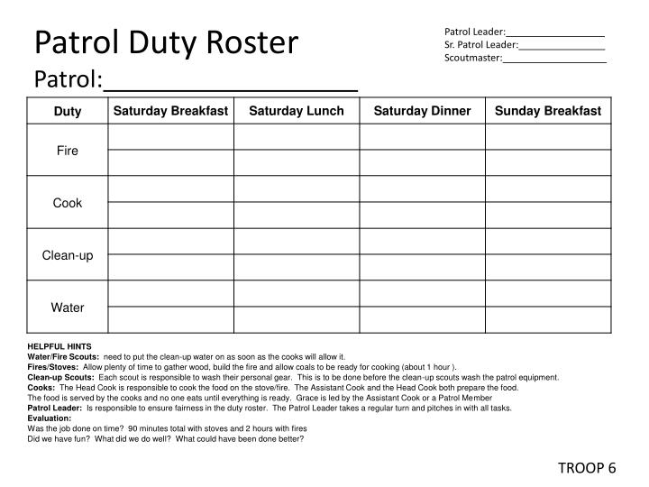
4a. Duty Roster

Slide 31
Requirement 4b
Help a Scout patrol or a Webelos Scout unit in your area prepare for an actual campout, including creating the duty roster, menu planning, equipment needs, general planning, and setting up camp.

Slide 32
4b. Planning a Campout
These requirements can easily be done within your own troop. Take this opportunity to speak with a troop leader and familiarize yourself with how your troop handles their duty roster. On your next campout, ask your patrol leader for help completing this requirement.
After your patrol has met to plan the next campout, note down each of your patrol members’ duties. Help plan the menu, equipment needs, and general planning. Once you’ve arrived at the camp, you can finally assist in helping set up.

Slide 33
Requirement 5a
Prepare a list of clothing you would need for overnight campouts in both warm and cold weather. Explain the term 'layering'.

Slide 34
5a Packing list
Cold Weather
Warm Weather
Long-sleeved shirt
Long pants (fleece or wool lined)
Sweater (fleece or wool)
Long underwear (polypropylene)
Socks (wool or synthetic blend)
Warm hooded parka or jacket
Stocking hat (fleece or wool)
Mittens or gloves (fleece or wool) with water-resistant shells
Wool scarf
Rain gear
T-shirt or short-sleeved shirt (lightweight)
Hiking shorts
Underwear
Socks
Long-sleeved shirt (lightweight)
Long pants (lightweight)
Sweater or warm jacket
Brimmed hat
Bandannas
Rain gear

Slide 35
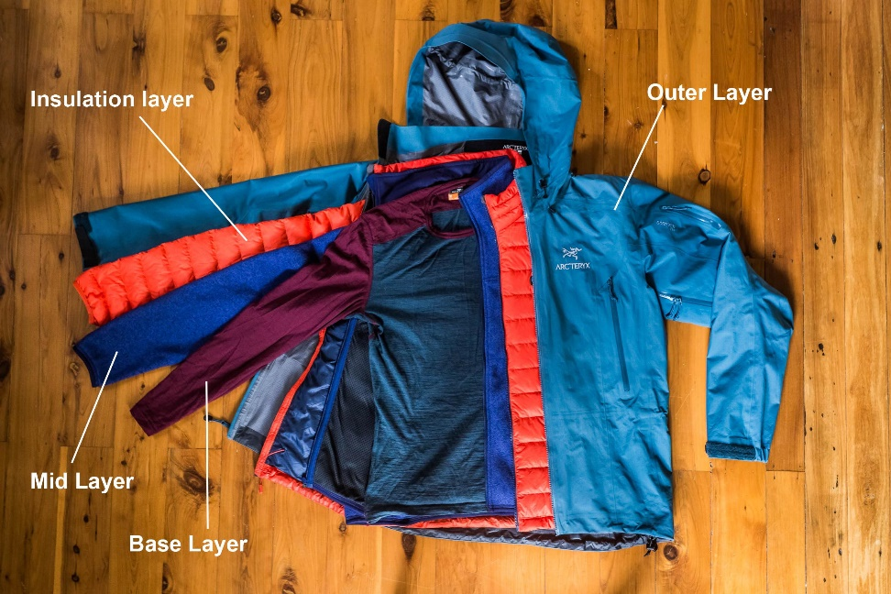
5a Layering
Layering lets you regulate comfort by slipping layers on and off as your activity level or the weather changes.
  Base layer (underwear layer): wicks sweat off your skin
  Middle layer (insulating layer): retains body heat to protect you from the cold
  Outer layer (shell layer): shields you from wind and rain
Even if you don’t wear all three layers at the outset, it’s a good idea to take all layers on every outing: You can peel off layers if things heat up, but you can’t put on layers that you didn’t bring along.

Slide 36
Requirement 5b
Discuss footwear for different kinds of weather and how the right footwear is important for protecting your feet.

Slide 37
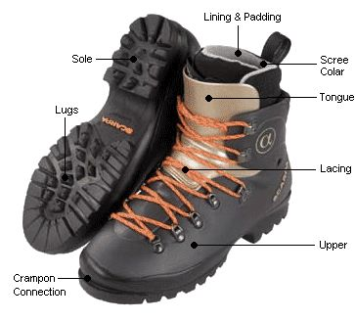
5b Footwear
Arguably one of your most important pieces of equipment!

Slide 38
5b. Footwear
Determine if your trek will take place in a wet or dry environment.
  In a wet environment, slow-drying shoes can mean an increased chance of blisters and feet infections.
  You’ll need to pack shoes that can be dried on the go and are resistant to moisture damage.
  Be sure that your feet are also well-supported if you will be walking long distances, and remember to bring a change of footwear.
In cold, damp environments, you’ll want to pack insulated, warm, waterproof shoes that will stand up to the outdoor conditions.
Failing to choose the right footwear to protect your feet is one of the biggest mistakes that inexperienced campers make.

Slide 39
5b Footwear
Choosing the right hiking boots is a matchmaking process. Your dream hiking boots need to sync with how and where you hike. Before you tie the knot, though, you also have to be sure they’re a perfect fit.
  Types: You have a dizzying array of choices, from ultralight trail shoes to mountaineering boots.
  Components: Understanding a little more about what goes into uppers, lowers, midsoles, outsoles and other parts of a boot can help you refine your selection.
  Fit: No one ever loved a pair of ill-fitting boots. The difference between blisters and bliss is taking the time to get a great fit.

Slide 40
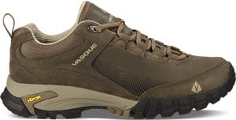
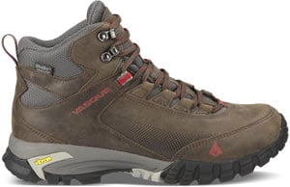
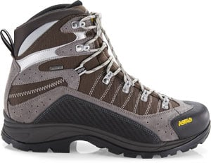
5b Footwear: Types
Hiking shoes: Low-cut models with flexible midsoles are excellent for day hiking. Some ultralight backpackers may even choose trail-running shoes for long-distance journeys.
Day hiking boots: These range from mid- to high-cut models and are intended for day hikes or short backpacking trips with light loads. They often flex easily and require little break-in time, but they lack the support and durability of stout backpacking boots.
Backpacking boots: These are designed to carry heavier loads on multiday trips deep into the backcountry. Most have a high cut that wraps above the ankles for excellent support. Durable and supportive, with stiffer midsoles than lighter footwear, they are suitable for on- or off-trail travel.

Slide 41

5b Footwear: Components
Materials impact a boot’s weight, breathability, durability and water resistance.
Hiking Boot Uppers
  Full-grain leather: Full-grain leather offers excellent durability and abrasion resistance and very good water resistance. It’s most commonly used in backpacking boots built for extended trips, heavy loads and rugged terrain. It is not as light or breathable as nylon/split-grain leather combinations. Ample break-in time is needed before starting an extended trip.

Slide 42
5b Footwear: Components
Hiking Boot Uppers
  Split-grain leather: Split-grain leather is usually paired with nylon or nylon mesh to create a lightweight boot that offers excellent breathability. Split-grain leather "splits away" the rougher inner part of the cowhide from the smooth exterior. The benefit is lower cost, however, the downside is less resistance to water and abrasion (though many feature waterproof liners).

Slide 43
5b Footwear: Components
Hiking Boot Uppers
  Nubuck leather: Nubuck leather is full-grain leather that has been buffed to resemble suede. It is very durable and resists water and abrasion. It’s also fairly flexible, yet it too requires ample time to break in before an extended hike.

Slide 44
5b Footwear: Components
Hiking Boot Uppers
  Synthetics: Polyester, nylon and so-called "synthetic leather" are all commonly found in modern boots. They are lighter than leather, break in more quickly, dry faster and usually cost less. Downside: They may show wear sooner due to more stitching on the outside of the boot.

Slide 45
5b Footwear: Components
Hiking Boot Uppers
  Waterproof membranes: Boots and shoes billed as “waterproof” feature uppers constructed with waterproof/breathable membranes (such as Gore-Tex® or eVent®) to keep feet dry in wet conditions. Downside: The reduced breathability created by a membrane (compared to the ventilating mesh used on some non-waterproof shoes) may encourage feet to sweat on summer days.

Slide 46
5b Footwear: Components
Hiking Boot Uppers
  Insulation: Synthetic insulation is added to some mountaineering boots for warmth when hiking on snow and glaciers.

Slide 47

5b Footwear: Components
Hiking Boot Midsoles
  The midsole, which provides cushioning, buffers feet from shock and largely determines a boot’s stiffness. Stiff boots might not sound like a good thing, but for long hikes on rocky, uneven terrain they can mean greater comfort and stability. A stiff boot won’t allow your foot to wear out by wrapping around every rock or tree root you step on. The most common midsole materials are EVA (ethylene vinyl acetate) and polyurethane.
    EVA is a bit cushier, lighter and less expensive. Midsoles use varying densities of EVA to provide firmer support where needed (e.g., around the forefoot).
    Polyurethane is generally firmer and more durable, so it’s usually found in extended backpacking and mountaineering boots.

Slide 48
5b Footwear: Components
Hiking Boot Internal Support
  Shanks: These 3–5mm thick inserts are sandwiched between a boot’s midsole and outsole to add load-bearing stiffness to the midsole. They vary in length; some cover the entire length of the midsole, while others only cover half.
  Plates: These thin, semi-flexible inserts are positioned between the midsole and the outsole, and below the shank (if included). They protect feet from getting bruised by roots or uneven rocks.

Slide 49
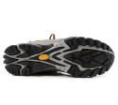
5b Footwear: Components
Hiking Boot Outsoles
  Rubber is used on all hiking boot outsoles. Additives such as carbon are sometimes added to backpacking or mountaineering boots to boost hardness. Hard outsoles increase durability but can feel slick if go you off trail.
  Lug pattern: Lugs are traction-giving bumps on the outsole. Deeper, thicker lugs are used on backpacking and mountaineering boots to improve grip. Widely spaced lugs offer good traction and shed mud more easily.
  Heel brake: This refers to the clearly defined heel zone that is distinct from the forefoot and arch. It reduces your chance of sliding during steep descents.

Slide 50
5b Hiking Boot Fit
Hiking boots should fit snug everywhere, tight nowhere and offer room to wiggle your toes.
Know your size. Have your foot's length, width and arch length measured on a specially calibrated fit device. Foot volume, another key to good fit, must be assessed by a specialist at a store.
  Double-check length by pulling the insoles out of the boots and standing on them; you should have a thumb’s width of space between your longest toe and the end of the insole.
Try on boots at the end of the day. Your feet normally swell a bit during the day’s activities and will be at their largest then. This helps you avoid buying boots that are too small.
If you wear orthotics, bring them along. They impact the fit of a boot.
Wear appropriate socks. Try them on with the socks you plan to wear. On the trail, go with synthetic rather than slow-drying cotton socks, which are more likely to give you blisters.
Spend some time in the boots. Take a stroll through the store. Walk up and down stairs. Find an inclined surface and walk on it.
Fit issues to share with your footwear specialist: You don't want to feel odd bumps or seams, or pinching in the forefoot, nor toes hitting the end of the boot when it's on an incline. If the boots are laced firmly and you still feel space above the top of your foot, then the volume of the boot is wrong.

Slide 51
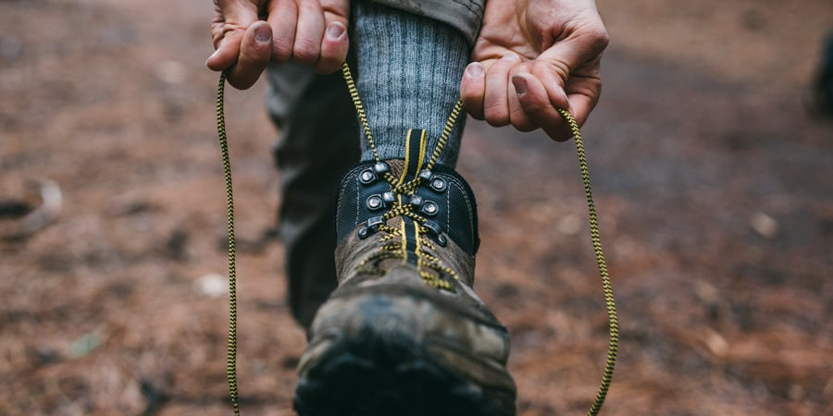
5b Hiking Boot Fit
Be sure to break in new boots before using them in the field.
Wear them several times, gradually extending the length of time you wear them, until they feel like a natural part of your feet.
Too many sore-footed hikers overlook this important step.

Slide 52
Requirement 5c
Explain the proper care and storage of camping equipment (clothing, footwear, bedding).

Slide 53
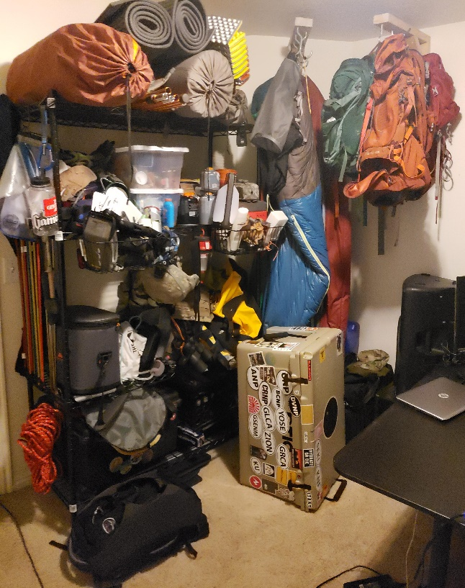
5c Care and Storage of Camping Equipment
Never put your gear away when it’s dirty or wet.
Clean the mud, dirt, sand, etc. off and, even more important, let it have enough to time to dry and air out before you pack it away.
Organize your gear in sealable plastic tubs or cardboard boxes and keep it all in a cool, dry place.

Slide 54
5c. Care and Storage of Camping Equipment
A few specifics:
  Tent: Set it up in the backyard when you get home. Make sure everything is dry, because a tent packed away wet can quickly mold, mildew and rot. Clean the dirt or sand off tent stakes and poles.
  Sleeping bag: Air it out and then hang it up on a hanger in a closet or lay it out flat under the bed. Don’t store a sleeping bag long term inside its stuff sack because that can reduce the effectiveness of the insulation inside.
  Electronics: For long-term storage of flashlights, headlamps, GPS, etc., always remove the batteries to prevent corrosion or leakage. Then store your batteries in a sealed plastic bag nearby.
  Cooking gear: Make sure your pots, pans, utensils and stove are all clean. Stray food drippings and crumbs will eventually attract insects and rodents.

Slide 55
Requirement 5d
List the outdoor essentials necessary for any campout, and explain why each item is needed.

Slide 56
5d. Outdoor Essentials
Packing the “Ten Essentials” whenever you step into the backcountry, even on day hikes, is a good habit.
On a routine trip you may use only a few of them or none at all.
It’s when something goes awry that you’ll truly appreciate the value of carrying these items that could be essential to your survival.

Slide 57
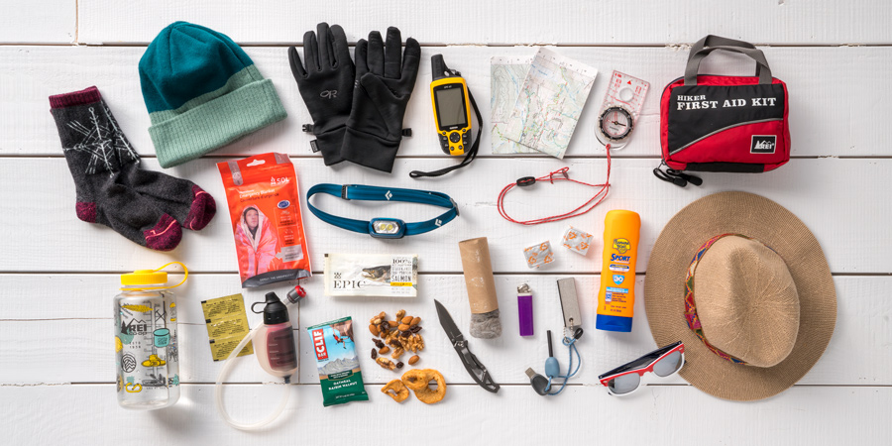
5d. Outdoor Essentials
Ten Essentials
Navigation: map, compass, altimeter, GPS device, personal locator beacon (PLB) or satellite messenger
Headlamp: plus extra batteries
Sun protection: sunglasses, sun-protective clothes and sunscreen
First aid: including foot care and insect repellent (as needed)
Knife: plus a gear repair kit
Fire: matches, lighter, tinder and/or stove
Shelter: carried at all times (can be a light emergency bivy)
Extra food: Beyond the minimum expectation
Extra water: Beyond the minimum expectation
Extra clothes: Beyond the minimum expectation

Slide 58
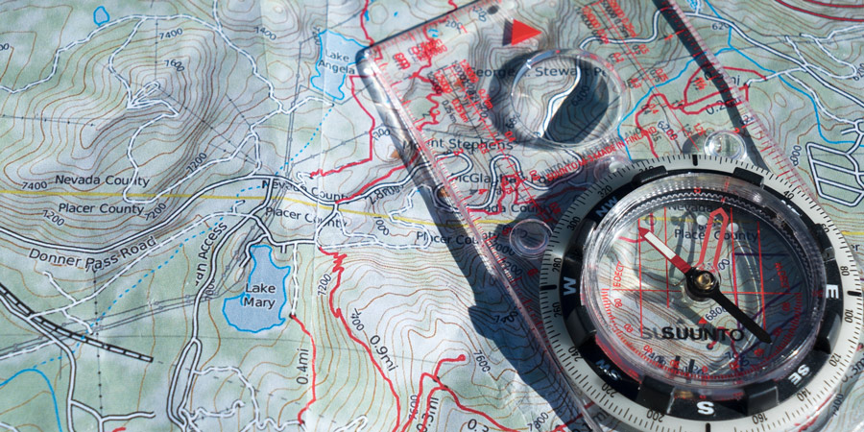
5d. Outdoor Essentials
Navigation
Map: A topographic map should accompany you on any trip that involves anything more than a short, impossible-to-miss footpath or frequently visited nature trail.
Compass: A compass, combined with map-reading knowledge, is a vital tool if you become disoriented in the backcountry.
GPS device: A GPS device allows you to accurately find your location on a digital map.
Personal locator beacon (PLB) or satellite messenger: These gadgets can be used to alert emergency personnel if you need help in the backcountry.

Slide 59
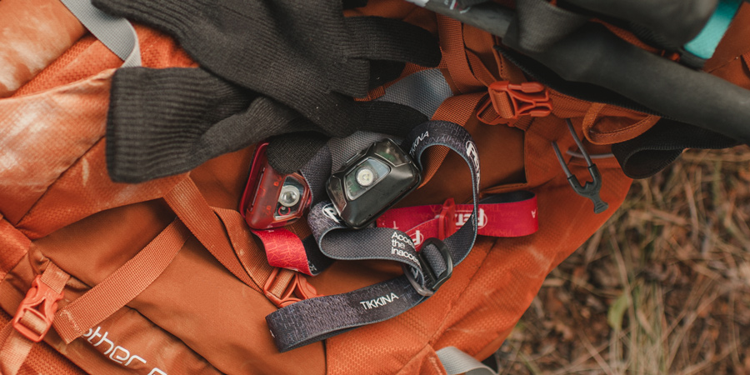
5d. Outdoor Essentials
Headlamp
Being able to find your way through the wilderness at night is essential, so you always need to have a light source with you.
A headlamp is the preferred choice of most backcountry travelers because it keeps your hands free for all types of tasks, whether that’s cooking dinner or holding trekking poles.
Always carry extra batteries.

Slide 60
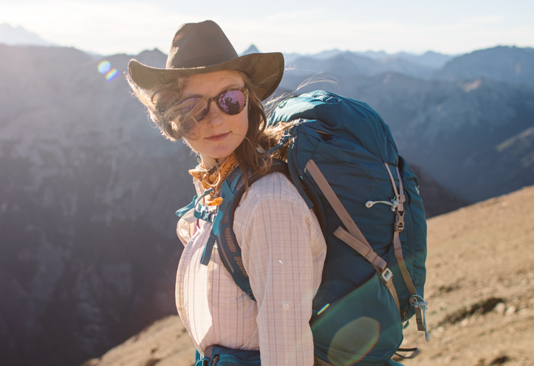
5d. Outdoor Essentials
Sun Protection
Sunglasses: Quality sunglasses are indispensable in the outdoors to protect your eyes from potentially damaging radiation.
Sunscreen: Spending long hours outdoors can expose you to ultraviolet rays, the cause of sunburn, premature skin aging and skin cancer.
  When selecting a sunscreen, health experts advise choosing a formula that offers a sun protection factor (SPF) of at least 15.
  Apply the sunscreen generously and thoroughly to all exposed skin.
  Depending on many factors (time of day, sweat and more), you should reapply as often as every two hours.
  Don’t overlook SPF-rated lip balm.
Sun-protection clothing: Clothing can be an effective way of blocking UV rays from reaching your skin without having to slather on sunscreen.

Slide 61
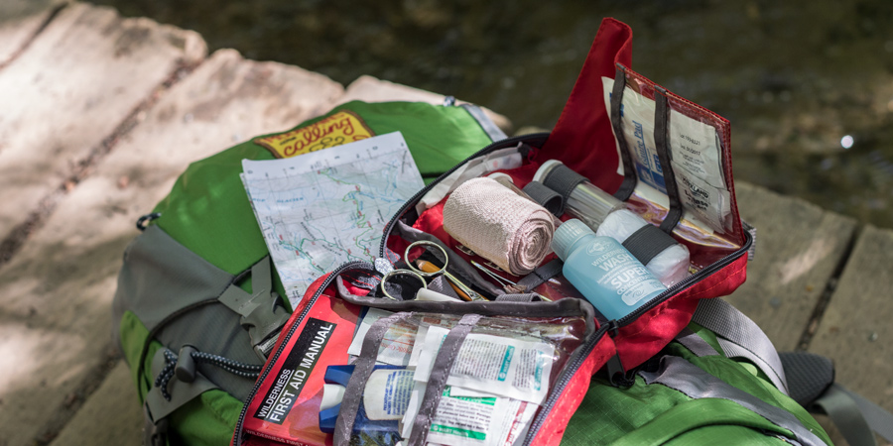
5d. Outdoor Essentials
First Aid
It’s vital to carry and know how to use the items in a first-aid kit.
Pre-assembled first-aid kits take the guesswork out of building your own, though many people personalize these kits to suit individual needs.
Any kit should include treatments for blisters, adhesive bandages of various sizes, several gauze pads, adhesive tape, disinfecting ointment, over-the-counter pain medication, nitrile gloves, pen and paper.
The length of your trip and the number of people involved will impact the contents of your kit.
It's also a good idea to carry some sort of compact guide to dealing with medical emergencies.

Slide 62
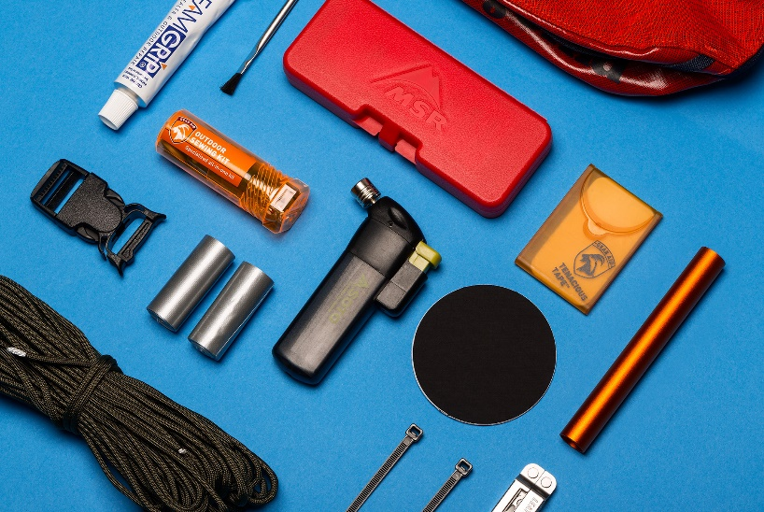
5d. Outdoor Essentials
Knife
Knives are handy for gear repair, food preparation, first aid, making kindling or other emergency needs, making them an essential for every outing.
A basic knife may have only a single foldout blade; more elaborate knives and multitools include things like one or two flathead screwdrivers, a can opener and/or a pair of foldout scissors.
In addition, a small gear repair kit can get you out of a bind in the backcountry (and the more remote you are, the more important your kit becomes).
  Common items include duct tape, cordage, fabric repair tape, zip ties, safety pins and repair parts for a water filter, tent poles, stove, and sleeping pad.

Slide 63
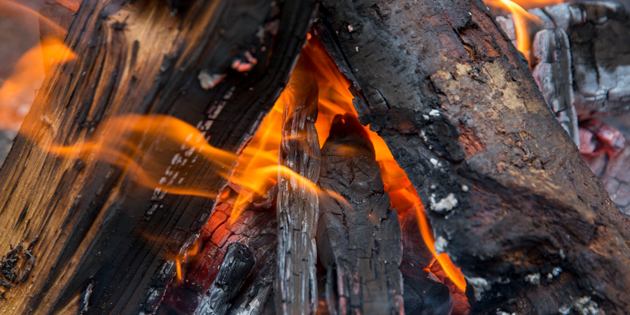
5d. Outdoor Essentials
Fire
In case of an emergency, you need to have reliable supplies with you for starting and maintaining a fire. For many people, this is a disposable butane lighter, but matches are also suitable so long as they are waterproof or stored in a waterproof container.
A firestarter is an element that helps you jump-start a fire and is indispensable in wet conditions.
  The ideal firestarter ignites quickly and sustains heat for more than a few seconds.
For outings where firewood is not available, such as trips above tree line and/or on snow, a stove is recommended as an emergency heat and water source.

Slide 64
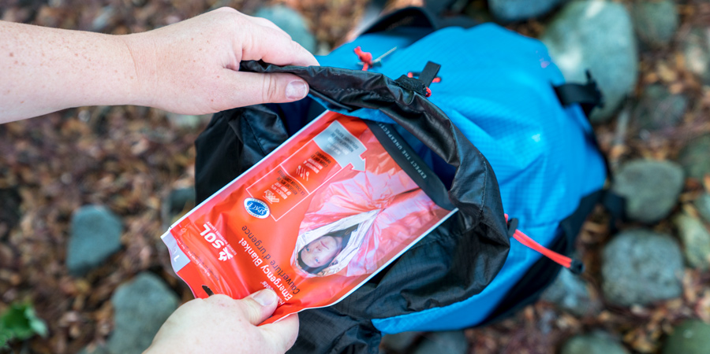
5d. Outdoor Essentials
Emergency Shelter
Always carry some type of emergency shelter to protect you from wind and rain in case you get stranded or injured on the trail.
Options include an ultralight tarp, a bivy sack, an emergency space blanket (which packs small and weighs just ounces) or even a large plastic trash bag.
It’s important to understand that your tent is only your emergency shelter if you have it with you at all times (a tent left behind at your camp is not sufficient).

Slide 65
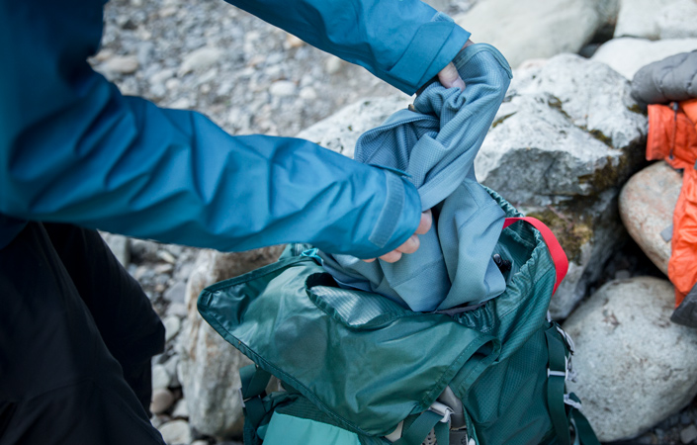
5d. Outdoor Essentials
Extra Clothes
Conditions can abruptly turn wet, windy or chilly in the backcountry, or an injury can result in an unplanned night out.
It’s necessary to carry extra clothes beyond those required for your trip.
When deciding what to bring, think about what you would need to survive a long, inactive period out in the elements.
  Common options include a layer of underwear (tops and bottoms), an insulating hat or balaclava, extra socks, extra gloves and a synthetic jacket or vest.
  For winter outings, bring insulation for your upper body and legs.

Slide 66
Requirement 5e
Present yourself to your Scoutmaster with your pack for inspection. Be correctly clothed and equipped for an overnight campout.

Slide 67
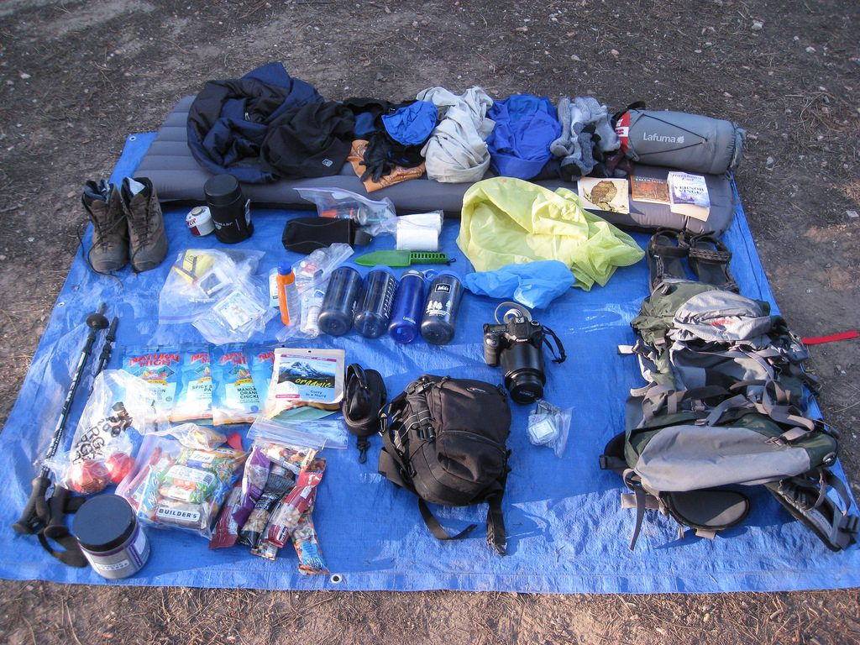
5e. Backpacking Shakedown
Have an experienced backpacker cull through your backpack eliminating unnecessary or heavy pieces of gear while recommending lighter replacements.
Pack the heaviest gear closer to your back, lighter gear away from your back, frequently used items on the top, and less frequently used items on the bottom.
Do not put important things at the bottom of your pack. If you’re expecting rain, the last thing you want to deal with is digging through your pack for your rain jacket.

Slide 68
Requirement 6a
Describe the features of four types of tents, when and where they could be used, and how to care for tents. Working with another Scout, pitch a tent.

Slide 69
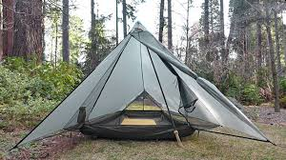
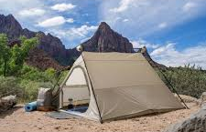
6a. Four Types of Tents
Tarps. The simplest of all tents, a tarp can be pitched in many ways—as a lean-to, for instance, or a pyramid, or a pup tent. The advantages of a tarp are its light weight and versatility. However, it has no floor, offers little protection against insects, and must be pitched well in order to protect campers from rain. Tarps often are used as dining flies to shelter group cook sites.
A-Frames. Seen from the front, this tent is shaped like the letter A, thus its name. Most A-frame tents are equipped with mosquito netting, a rain fly, and a waterproof floor.

Slide 70
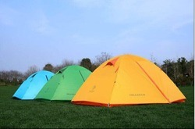
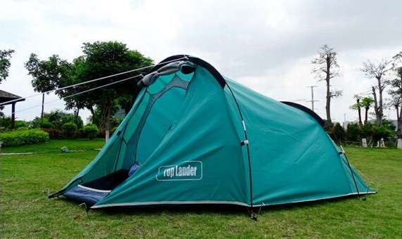
6a. Four Types of Tents
Domes. Tents with a dome shape can be spacious with lots of headroom. The arrangement of poles bending over the tent body gives a dome plenty of stability, even in strong winds. Domes are often freestanding—requiring no tent stakes. Since dome tents are usually larger than A-frames, they also can weigh more.
Hybrids. Among the most interesting are hybrid tents that combine features of A-frames and domes. Some look like rounded A-frames, tunnels, or domes cut in half. Doors may be at the ends, or sewn into one or both sides. Many include a vestibule—a porch-like extension of the rain fly that provides shelter outside the tent body for storing packs, crew gear, and muddy boots.

Slide 71
6a. Tent Care
Take off your boots before crawling into a tent and you won’t track in mud. Store your boots by the tent door, under the shelter of the rain fly.
The stitched seams in the rain flies of tents may need to be sealed with seam sealer to prevent moisture from leaking through.
Tent fabric can be harmed by too much exposure to sunlight. Try to avoid leaving it pitched in the open when it is not in use or when you can put it in a shaded campsite instead.
Clean out your tent when packing up by tipping it up and shaking out litter and debris.
To stow a tent in a storage sack, first place the bundle of collapsed poles in the tent’s stuff sack. Next, push a corner of the tent all the way to the bottom of the sack. Continue stuffing the fabric alongside the poles.
A tent that seems dry in camp may have absorbed dew or ground moisture. It is important that you always unpack your tent when you get home and set it up or hang it over a clothesline and allow it to dry completely before storing it.

Slide 72
Requirement 6b
Discuss the importance of camp sanitation and tell why water treatment is essential. Then demonstrate two ways to treat water.

Slide 73
6b. Camp Sanitation
Getting rid of human waste outdoors requires special care. In campgrounds that have rest rooms or outhouses, be sure to use them. Where those don’t exist, dig a cathole or use a latrine.
Wash your hands with soap and water or use a waterless hand cleanser when you are done.
Cathole. Find a private spot at least 200 feet (75 steps) from water, campsites, and trails. Dig a hole 6 to 8 inches deep with your heel, a stick, or a shovel. Organisms in the top layers of earth will break down human waste. Fill the cathole with soil when you are done, and replace any ground cover. Push a stick into the earth to warn others against digging in the same spot.
Latrine. A patrol, troop, or other large camping group may be able to lessen its impact on the land by digging a single latrine rather than making many catholes.

Slide 74
6b. Water Treatment
Water taken from streams, lakes, and springs may contain bacteria and parasites too small for you to see.
Treat any water that does not come from a tested source using one of the following methods.
  Boiling.
  Treatment Tablets.
  Filters.

Slide 75
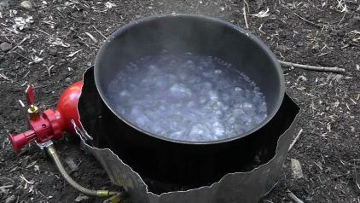
6b. Water Treatment
Boiling
  Bringing water to a rolling boil for a full minute or more will kill most organisms.

Slide 76


6b. Water Treatment
Treatment Tablets
  Water treatment tablets are sold in small bottles just right for hikers and campers.
  The label usually instructs you to drop one or two tablets into a quart of water and then wait 30 minutes before drinking.
  Tablets may leave a chemical taste in the water.
  After the tablets have had a full 30 minutes to do their work, you can improve the flavor by adding some drink mix.

Slide 77
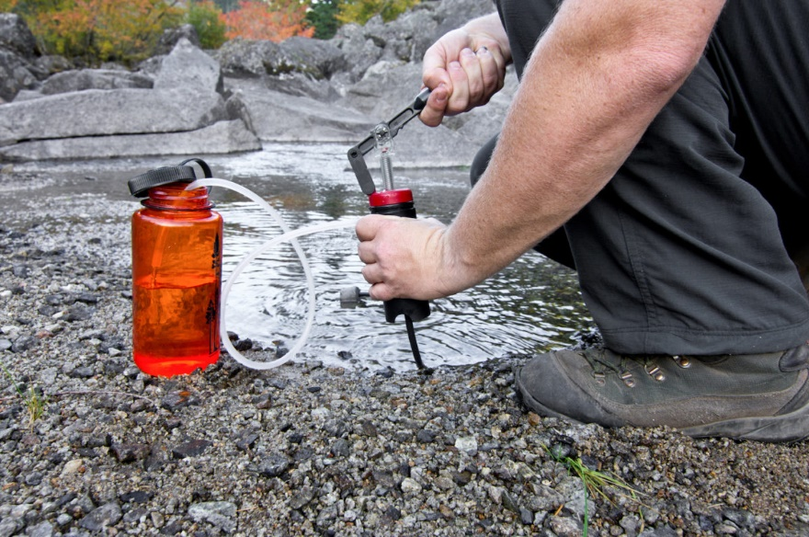
Filters
  Camping stores and catalogs offer water treatment filters that are effective and easy to use.
  Many operate by pumping water through pores small enough to strain out bacteria and may contain activated carbon to reduce odors and improve taste.
  Follow the instructions that come with the filter you plan to use.

Slide 78
Requirement 6c
Describe the factors to be considered in deciding where to pitch your tent.

Slide 79
6c. Where to Pitch a Tent
Selecting a Campsite
Safety
  Don’t pitch a tent under dead trees or limbs that might fall in a storm.
  Stay out of gullies that could fill with flash floods.
  Find a site away from lone trees, mountaintops, high ridges, and other likely targets of lightning.
  Camp some distance from game trails, especially in bear country.
Size
  A site must be large enough for members of your camping party to pitch their tents and cook their meals.
  When hanging food to keep it away from animals, find the trees you need at least 200 feet from where you will be sleeping.
Terrain
  Does the site you have chosen for camp slope gently for good drainage?
  Leaves, pine needles, and other natural cover can keep the ground from becoming muddy.
  An area open to the east and south will catch sunlight early in the day and perhaps be drier than slopes facing north.

Slide 80
6c. Where to Pitch a Tent
Selecting a Campsite
Privacy
  Respect the privacy of others.
  Trees, bushes, and the shape of the terrain can screen your camp from trails and neighboring campsites.
  Keep the noise down when other campers are staying nearby.
Permission
  Check well ahead of time with land managers of public parks, forests, and reserves. They can issue any permits you will need and may suggest how you can make the most of your campouts.
  Get permission from owners before camping on private property.

Slide 81
6b. Managing Your Campsite
Once you arrive at a site, the first order of business is to figure out the best way to settle in while causing little impact on the land.
Set up a dining fly first. That will provide shelter for food and you in case of rain and will give a sense of where you will center most of your camp activities.
Pitch your tents. Use established tent sites whenever possible. In bear country, tents should be 200 feet or more from the cooking area and from areas where food will be stored.
Establish a plan for personal sanitation and be sure everyone understands what he is to do.

Slide 82
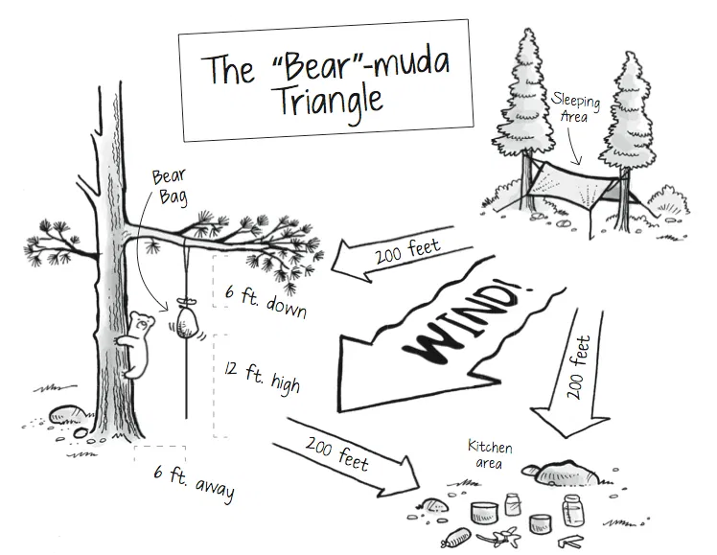
6b. Camp Layout

Slide 83
Requirement 6d
Tell the difference between internal and external frame packs. Discuss the advantages and disadvantages of each.

Slide 84

6d. Internal vs. External Frame Backpacks
Internal frame packs are more sleek and form-fitting. They hold the load closer to the body.
External frame packs have a more square pack bag and visible frame elements, which are good for lashing on bulky gear.

Slide 85
6d. Internal vs. External Frame Backpacks
Support:
  An external pack transfers the load nicely to your hips and allows an upright walking position that some find comfortable, though it also makes you less agile if you need to move quickly.
  An internal pack’s closeness creates stability, and most have suspension systems that transfer the load to hips efficiently.
Weight:
  Externals’ thick frame pieces make them heavier.
  Internals’ frames are lighter and you can find a range of options from lightweight to ultralight.
Fit:
  Adjustable suspension systems on externals are rare, so you need to be sure the pack comes in a size that’s a decent fit for you.
  Many internals come with an adjustable suspension that allows you to get a more precise fit.

Slide 86
6d. Internal vs. External Frame Backpacks
Cooling:
  Externals have a large gap between the frame and packbag that allows air to flow across your back.
  Some internals might have ventilation channels that offer a little bit of cooling.
Storage:
  Capacity measurements are done the same way for each type of pack, so a 60-liter external frame pack holds the same amount of gear inside as a 60-liter internal-frame pack.
  The exposed frame pieces on external packs are good for lashing on bulky and heavy items.
  Internal packs often have lash patches that allow you to attach some additional gear.
Organization:
  Externals typically include lots of outer pockets that help you organize things; access to the main compartment is typically through the top of the pack bag.
  Internals, by contrast, range from ultralight packs with very few pockets to deluxe designs with pockets aplenty.
  The access to the main compartment on internals also varies: It might be from the top or a front panel, with some models also offering side zippers to reach deep-down items.

Slide 87
Requirement 6e
Discuss the types of sleeping bags and what kind would be suitable for different conditions. Explain the proper care of your sleeping bag and how to keep it dry. Make a comfortable ground bed.

Slide 88
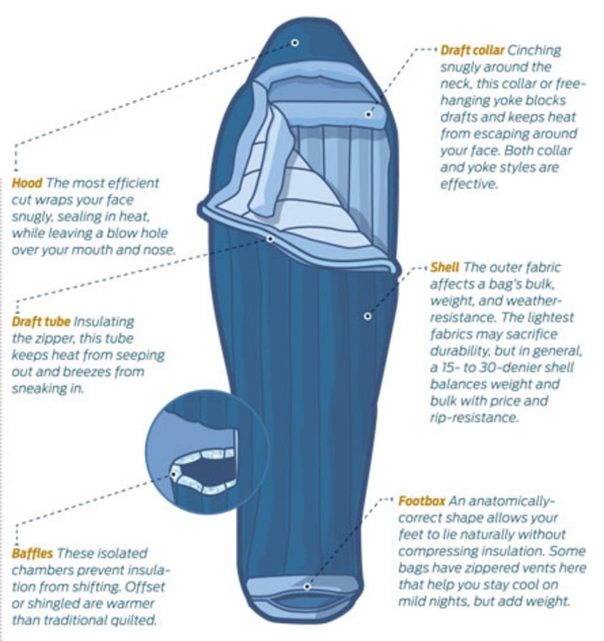
6e. Sleeping Bag Construction
The outer fabric of a sleeping bag is called the shell.
  Usually made of nylon, it can shield you from gusts of wind and may be treated by the manufacturer to repel dew and light mist.
Contained within the shell is an insulating fill material that traps your body warmth and holds it close to you.
  Thin fabric walls called baffles are sewn into the shell to keep the fill material spaced evenly throughout the bag.

Slide 89
6e. Sleeping Bags – Down vs. Synthetic
Down Bags:
  The warmest fill material per ounce is goose down.
  Down bags are expensive, cannot keep you warm when they are wet, and are difficult to dry in camp unless the sun comes out.
  Down bags are good when campers want to travel as lightly as possible and have the experience to keep their bags dry.
Synthetic Bags:
  Synthetic fill is slightly heavier than down.
  Synthetic fill bags are less costly.
  Its greatest advantage is that it can keep you warm even when your sleeping bag gets wet.

Slide 90
6e. Sleeping Bag Temperature Rating
Because waking up in your tent shivering in the middle of the night is a miserable experience, the key factor when you choose a sleeping bag is its temperature rating.
If you have a reasonable idea of the coldest conditions you anticipate on your adventure, you can pick a bag that will keep you warm at or below that temperature.
Temperature ratings are estimates, not gospel.

Slide 91
6e. Sleeping Bag Care
The useful life of any sleeping bag can be extended if you remove it from its stuff sack between trips. Store it by hanging it in a closet or by placing it loosely in a large cotton laundry bag. That will prevent the fill material from being overly compressed, and circulating air will help keep the bag fresh.

Slide 92
6e. Sleeping Pads
Increase your comfort at night with a sleeping pad.
Types of Sleeping Pads.
  Air pads come in a wide variety of styles, from lightweight ones ideal for backpacking up to extra-thick ones that are great for glamping.
  Self-inflating pads offer a combination of open-cell foam insulation and air.
  Closed-Cell Foam Pads.

Slide 93
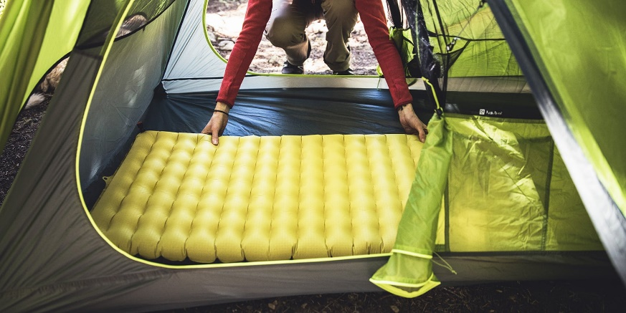
6e. Choosing a Sleeping Pad
Intended use: Decide which activity your pad is for: backpacking, car camping, winter camping, etc.
Warmth (R-value): A pad’s ability to resist heat loss to the ground is measured as R-value — higher R-values are warmer.
Sleep system: Being comfortable at a particular temperature depends on many other variables, including the temperature rating of your sleeping bag. Correctly pairing your pad and bag in your sleep system is key to staying warm.
Features: Decide which other features are most important to you: weight, cushioning, size, inflation ease and more.

Slide 94
Requirement 7a
Prepare for an overnight campout with your patrol by doing the following:
  Make a checklist of personal and patrol gear that will be needed.

Slide 95
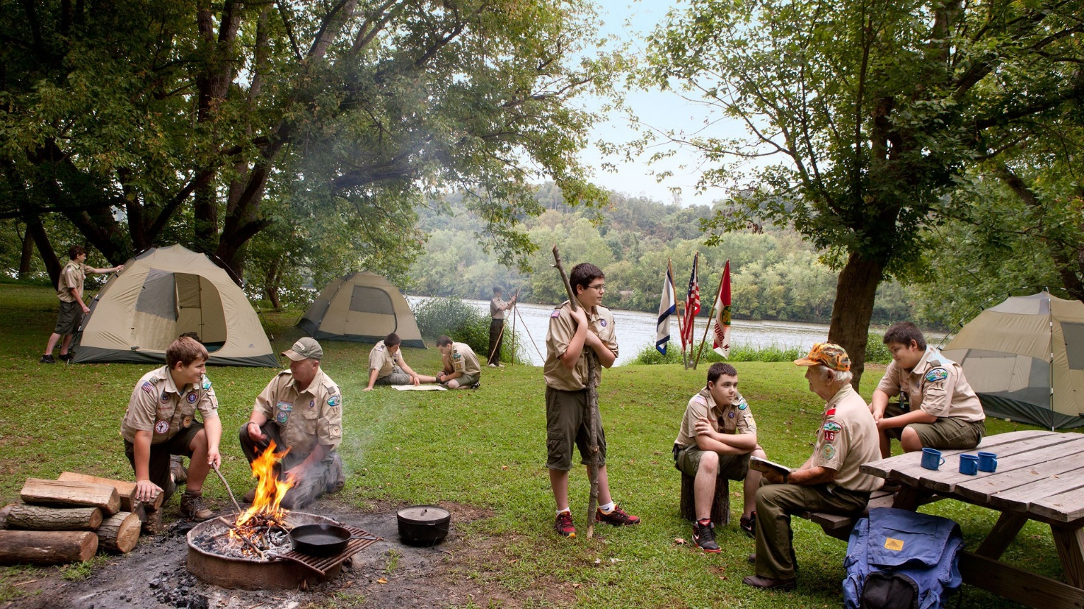
7a. Overnight Campout

Slide 96
7a. Personal Gear Checklist
Carry your outdoor essentials on every Scout outing.
When you want to camp out under the stars, add personal and group overnight gear.
Personal Overnight Camping Gear
  Clothing for the season (see box for warm and cold-weather camping)
  Backpack
  Rain cover for backpack
  Sleeping bag, or two or three blankets
  Ground cloth and pad
  Eating kit: spoon, plate, bowl, cup
  Cleanup kit: soap, toothbrush, toothpaste, dental floss, comb, washcloth, towel
  Personal extras (optional): watch, camera, notebook, pencil or pen, sunglasses, gloves

Slide 97
7a. Group Gear Checklist
Group Overnight Camping Gear
  Tents with poles, stakes, ground cloths, and lines
  Dining fly
  Nylon cord, 50 feet
  Backpacking stoves and fuel
  Cook kit: pots and pans, spatula, large spoon and/or ladle, plastic sheets (two 4-by-4-foot), matches and/or butane lighters in waterproof containers
  Cleanup kit: sponge or dishcloth, biodegradable soap, sanitizing rinse agent (bleach), scouring pads (no-soap type), plastic trash bags, toilet paper in plastic bag
  Repair kit: thread, needles, safety pins
  Group extras (optional): hot-pot tongs, camp shovel, plastic water container, washbasin, grill, pot rods, patrol flag, small U.S. flag, ax, camp saw

Slide 98
Requirement 7b
Prepare for an overnight campout with your patrol by doing the following:
  Pack your own gear and your share of the patrol equipment and food for proper carrying. Show that your pack is right for quickly getting what is needed first, and that it has been assembled properly for comfort, weight, balance, size, and neatness.

Slide 99

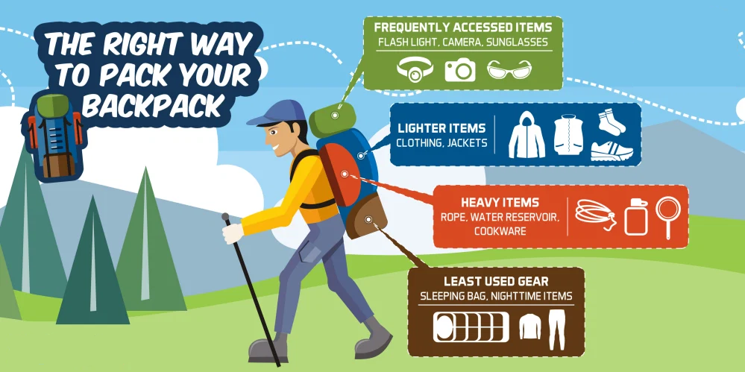
7b. Packing Your Gear
Click on the following link for a tutorial on packing your backpack:
How to Pack a Backpack the Right Way

Slide 100
Requirement 8a
Explain the safety procedures for:
    Using a propane or butane/propane stove
    Using a liquid fuel stove
    Proper storage of extra fuel

Slide 101
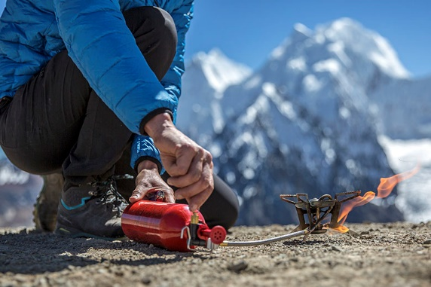
8a. Using Stoves Safely
Before lighting any stove, read the manufacturer’s instructions and follow the instructions exactly.
Always heed these stove safety rules:
  Never use a stove inside or near a tent.
  Don’t overload a stove with a heavy pot. Instead, set up a grill over the stove to bear the weight of the pot.
  Never leave a burning stove unattended.
  Let a stove cool completely before you put it away.
  For long-term storage, empty the fuel tank.
  Do not open the fuel cap of a hot stove or attempt to refuel a hot stove.
  Store liquid fuel only in well-marked metal fuel bottles designed specifically for that use.
  Keep fuel bottles and canisters away from sources of heat.
  Do not store fuel containers inside your house.

Slide 102
Requirement 8b
Discuss the advantages and disadvantages of different types of lightweight cooking stoves.

Slide 103
8b. Selecting a Stove
Selecting a Stove
  The stove you choose depends upon the kind of cooking you will do, the type of fuel you wish to use, and the amount of weight you are willing to carry.
  Always read and follow the manufacturer’s instructions for carrying, fueling, using, and storing camp stoves.

Slide 104
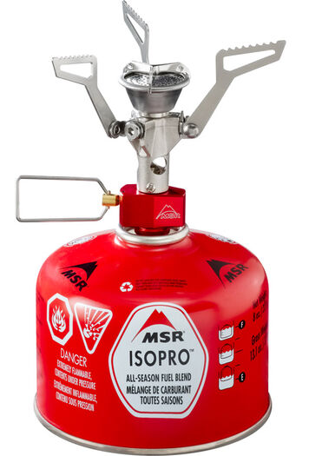
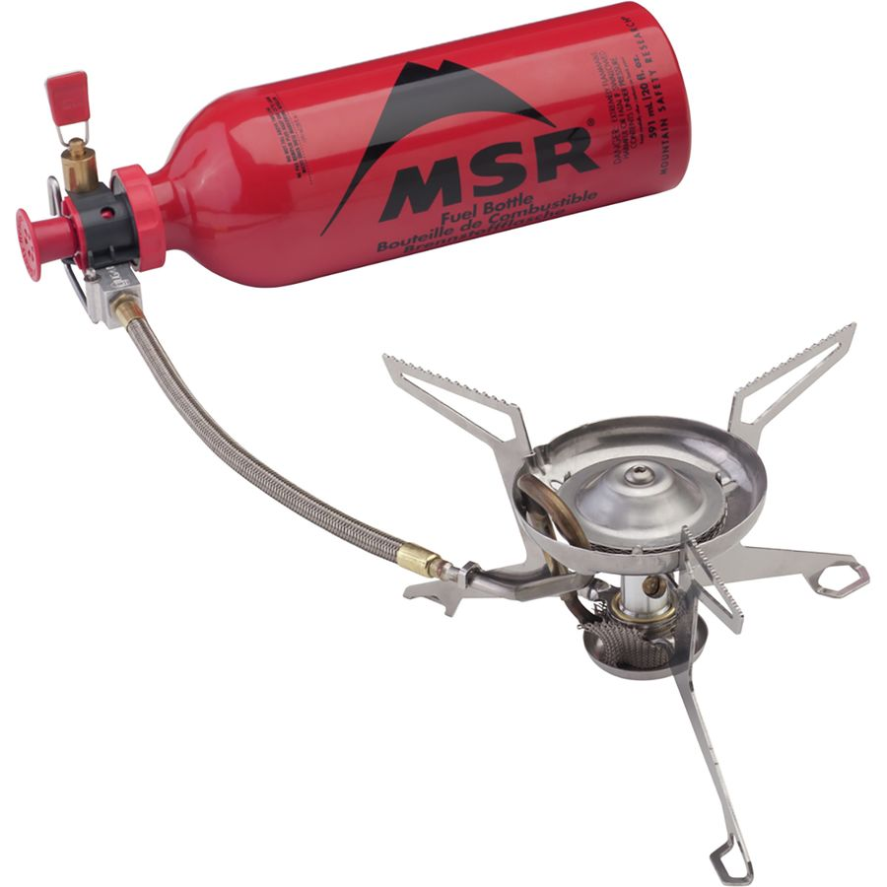
8b. Canister vs. Liquid Fuel Stoves
Canister Stove
Liquid Fuel Stove

Slide 105
8b. Canister vs. Liquid Fuel Stoves
Stove Weight
  Canister stoves are the clear winner in this category – they’re almost always lighter and more compact than their liquid fuel counterparts.
Fuel Weight
  A single fuel canister weighs less than a liquid fuel bottle, but a bunch of canisters can add up to significantly more weight than a liquid fuel bottle. Remember, you’ll have to carry canisters for the remainder of your trip – even after they’re spent.
  On a short trip that only requires a little cooking, the canister is king.
  If you’re on a long trip or planning to run the stove a lot, carrying a large bottle of liquid fuel is the best way to go.

Slide 106
8b. Canister vs. Liquid Fuel Stoves
Temperature
  In most cases, liquid fuel stoves offer the best performance in cold conditions.
  Cold temperatures create low canister pressure, rendering most canister stoves useless in really cold conditions.
Environmental Impact
  Liquid fuels require less energy input and offer a more environmentally friendly way to cook in the outdoors. The key is the reusable fuel bottle.
  Spent fuel canisters can be recycled as mixed metal (not aluminum) but not that many recycling programs take these metals, and even fewer recognize the canisters and process them.

Slide 107
8b. Canister vs. Liquid Fuel Stoves
Economy
  In most cases, canister stoves cost less than liquid fuel stoves.
  At the same time, canister fuel often costs considerably more than liquid fuel
Maintenance
  Canister stoves require practically zero maintenance to run reliably for decades.
  Liquid stoves are famous for their reliability, but require more maintenance.
  Luckily, the stoves are easy to work on and the cleaning process is simple.
Fuel Availability
  Canister fuel is available in a wide range of places, but not everywhere.
  If you’re planning on traveling in countries and regions well off the beaten path, liquid fuel is a safer bet.

Slide 108
Requirement 8c
Prepare a camp menu. Explain how the menu would differ from a menu for a backpacking or float trip. Give recipes and make a food list for your patrol. Plan two breakfasts, three lunches, and two suppers. Discuss how to protect your food against bad weather, animals, and contamination.

Slide 109
8c. Prepare a Camp Menu
Keep these suggestions in mind as you plan meals for a camping trip:
  Select foods that will not spoil. In the frontcountry, you may be able to bring fresh fruits and vegetables, and keep meat and dairy products safe in a cooler with ice. For backcountry treks, depend more upon grains, pastas, and dehydrated or dried ingredients.
  When you camp in the frontcountry or travel by watercraft or with pack animals, the weight of your food may not be a critical factor. Besides taking items that are fresh or canned, you might be able to include additional cooking gear, too — a Dutch oven for stews and baking desserts, for example, or a griddle for a big breakfast of pancakes, bacon, and eggs.
  Trim the weight of your backpack by eliminating water from your provisions. Grains, pastas, cereals, and dried or dehydrated fruits, vegetables, soup mixes, and sauces provide plenty of punch per pound.
  Repackage food in resealable plastic bags to reduce clutter and weight. On a piece of tape attached to each bag, write the contents of the bag and the meal for which it will be used.

Slide 110
8c. Menu and Recipe Ideas
Once you know how many meals you need, write down what you want to prepare and eat for each of those meals.
The menus here will give you some ideas:
  Trail breakfast: instant hot cereal, mixed dried fruits, cocoa.
  Camp breakfast: pancakes, apple, milk or orange juice.
  Trail lunch: peanut butter and jelly sandwich, carrot sticks, chocolate pudding, juice (canned or boxed).
  Camp lunch: hot dogs with condiments (pickle, relish, mustard, ketchup) pork ‘n’ beans, sliced pears, chocolate milk.

Slide 111
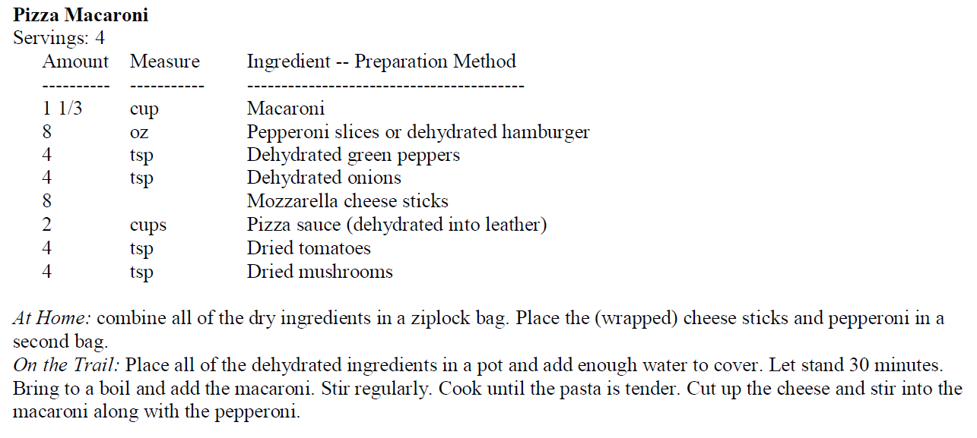
8c. Menu and Recipe Ideas

Slide 112
8c. Cleaning Up After Meals
Begin cleanup by setting out three pots:
  Hot-water wash pot—hot water with a few drops of biodegradable soap
  Hot-water rinse pot—clear, hot rinse water
  Cold-water rinse pot—cold water with a sanitizing tablet or a few drops of bleach to kill bacteria

Slide 113
8c. Dealing With Leftovers
Carry food scraps home in a trash bag.
Don’t bury leftover food or scatter it in the woods.
Animals will almost always find it, and it is not healthy for them to eat.
Food scraps can draw animals close to campsites where they may lose their fear of humans.
That can be dangerous for them and for you.

Slide 114
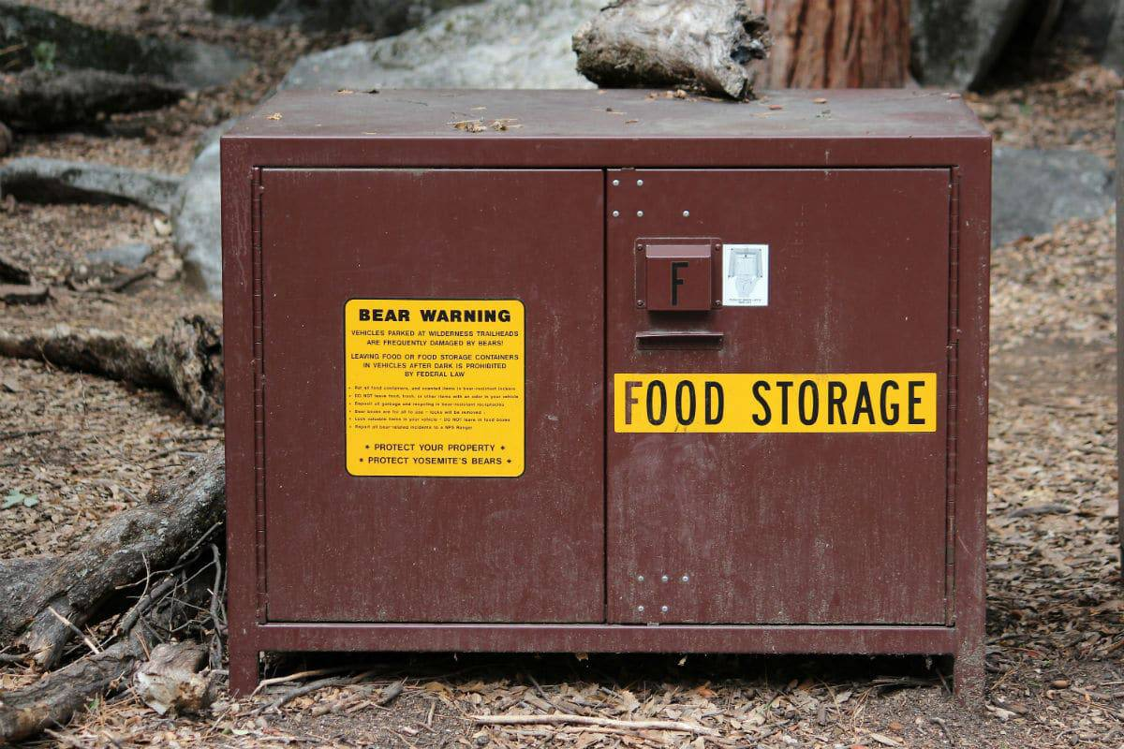
8c. Food Storage
Store your food where it will be safe from animals, insects, dust, debris, and bad weather.
Frontcountry campers can use vehicles, coolers, or plastic buckets with tightly fitted lids as storage units.
Use bear boxes if provided.

Slide 115
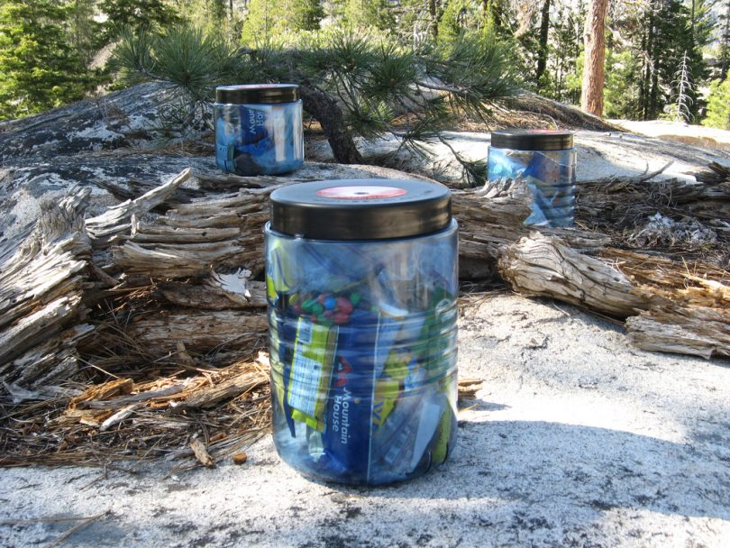
8c. Food Storage
In the backcountry and anywhere that bears may be present, a bear canister is often the answer.

Slide 116
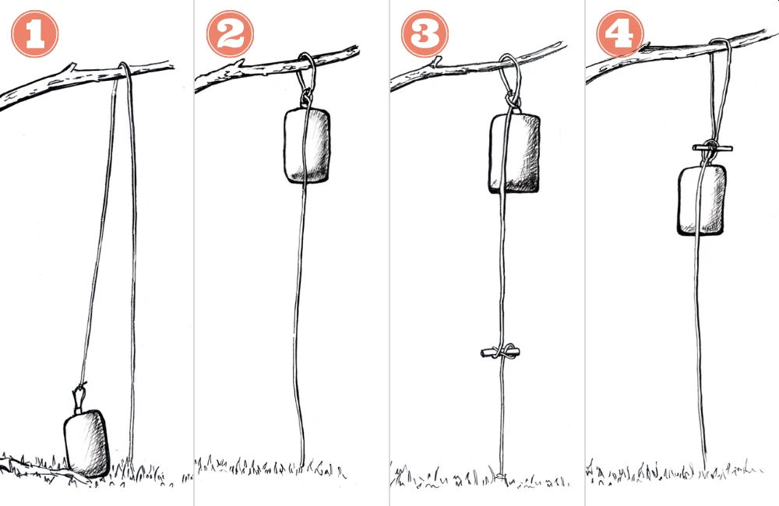
8c. Food Storage
Where permitted and if trees are available, hanging a bear bag is another option.

Slide 117
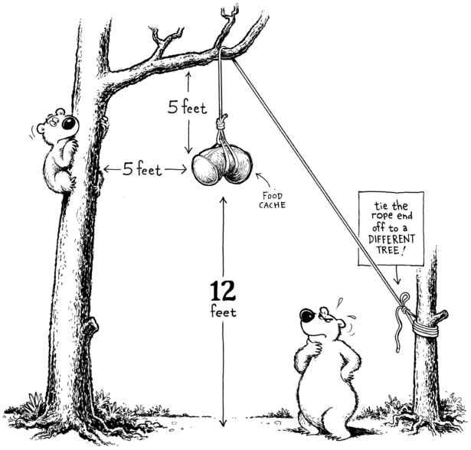

8c. Food Storage

Slide 118
Requirement 8d
While camping in the outdoors, cook at least one breakfast, one lunch, and one dinner for your patrol from the meals you have planned for requirement 8c. At least one of those meals must be a trail meal requiring the use of a lightweight stove.

Slide 119
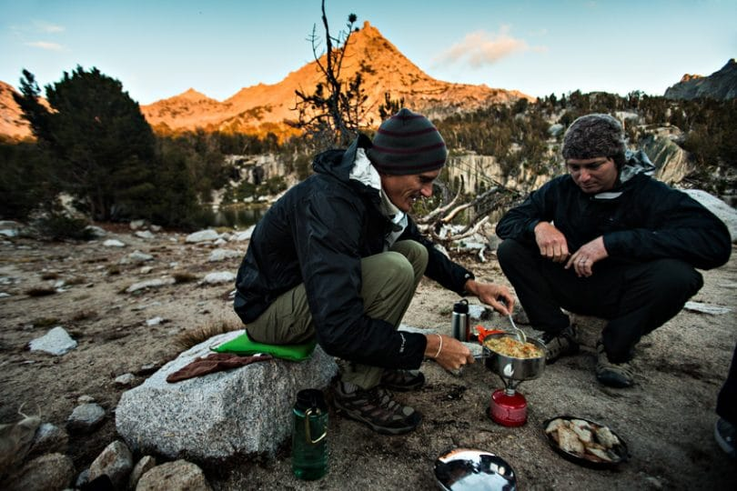
8d. Cooking a Trail Meal

Slide 120
Requirement 9a
Show experience in camping by doing the following:
  Camp a total of at least 20 nights at designated Scouting activities or events. One long-term camping experience of up to six consecutive nights may be applied toward this requirement. Sleep each night under the sky or in a tent you have pitched. If the camp provides a tent that has already been pitched, you need not pitch your own tent.

Slide 121
9a. Camp 20 Nights
Date of Camp | Camp Location | # of Nights | Date of Camp | Camp Location | # of Nights

Slide 122
Requirement 9b
Show experience in camping by doing the following:
  On any of these camping experiences, you must do TWO of the following, only with proper preparation and under qualified supervision:
    Hike up a mountain where, at some point, you are at least 1,000 feet higher in elevation from where you started.
    Backpack, snowshoe, or cross-country ski for at least four miles.
    Take a bike trip of at least 15 miles or at least four hours.
    Take a non-motorized trip on the water of at least four hours or 5 miles.
    Plan and carry out an overnight snow camping experience.
    Rappel down a rappel route of 30 feet or more.

Slide 123
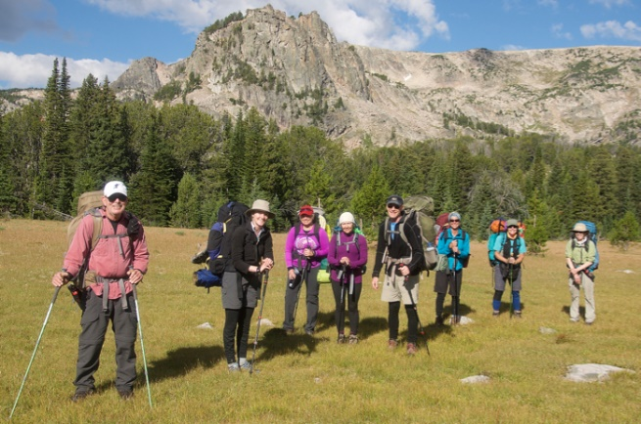
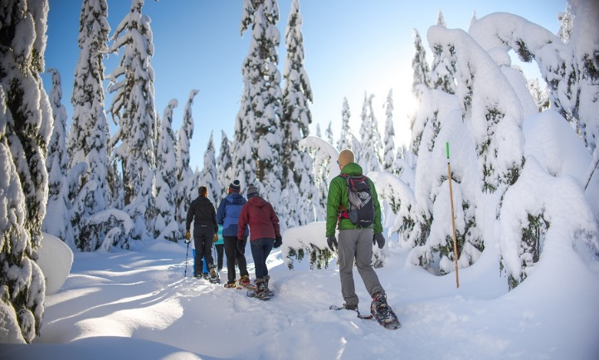
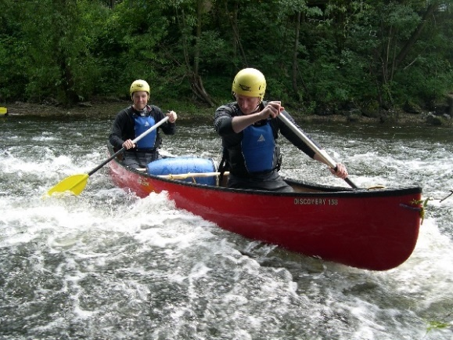
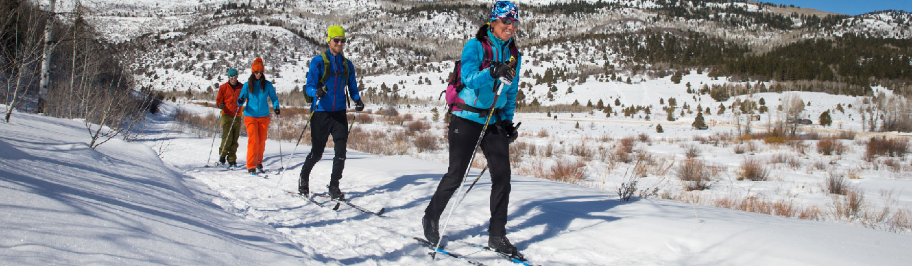
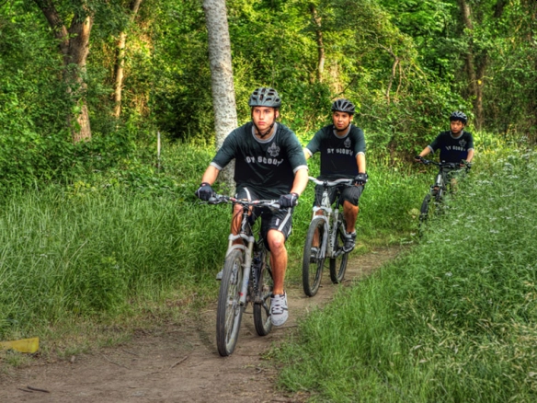
9b. Show Experience in Camping

Slide 124
Requirement 9c
Show experience in camping by doing the following:
  On any of these camping experiences, perform a conservation project approved by the landowner or land managing agency. This can be done alone or with others.

Slide 125
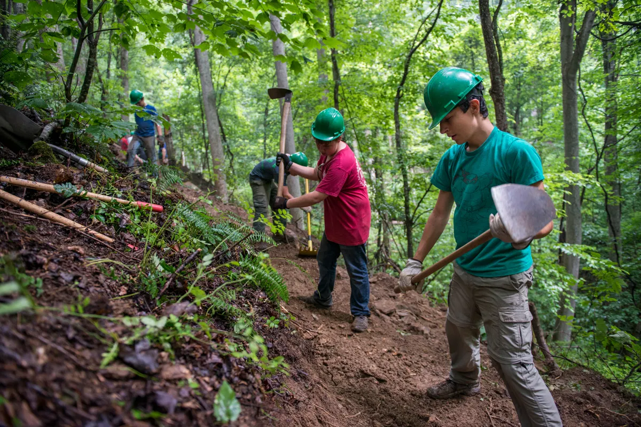
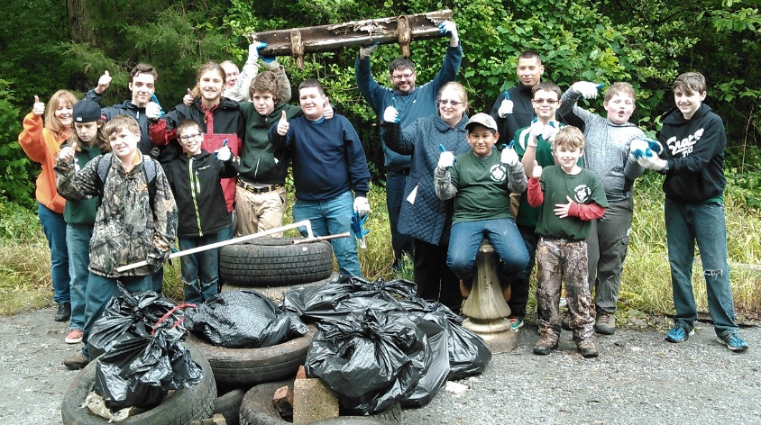
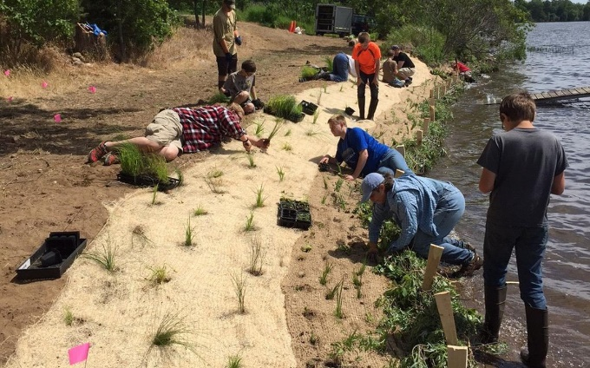
9c. Conservation Project

Slide 126
Requirement 10
Discuss how the things you did to earn this badge have taught you about personal health and safety, survival, public health, conservation, and good citizenship. In your discussion, tell how Scout spirit and the Scout Oath and Law apply to camping and outdoor ethics.

Slide 127
10. What Have You Learned?
This one is on you! What were some of the things you did in earning this badge? What have been some of your favorite moments while camping? How did you show scout spirit in overcoming the outdoor challenges you encountered? Do you like camping any more now than when you started?

